Slide 1
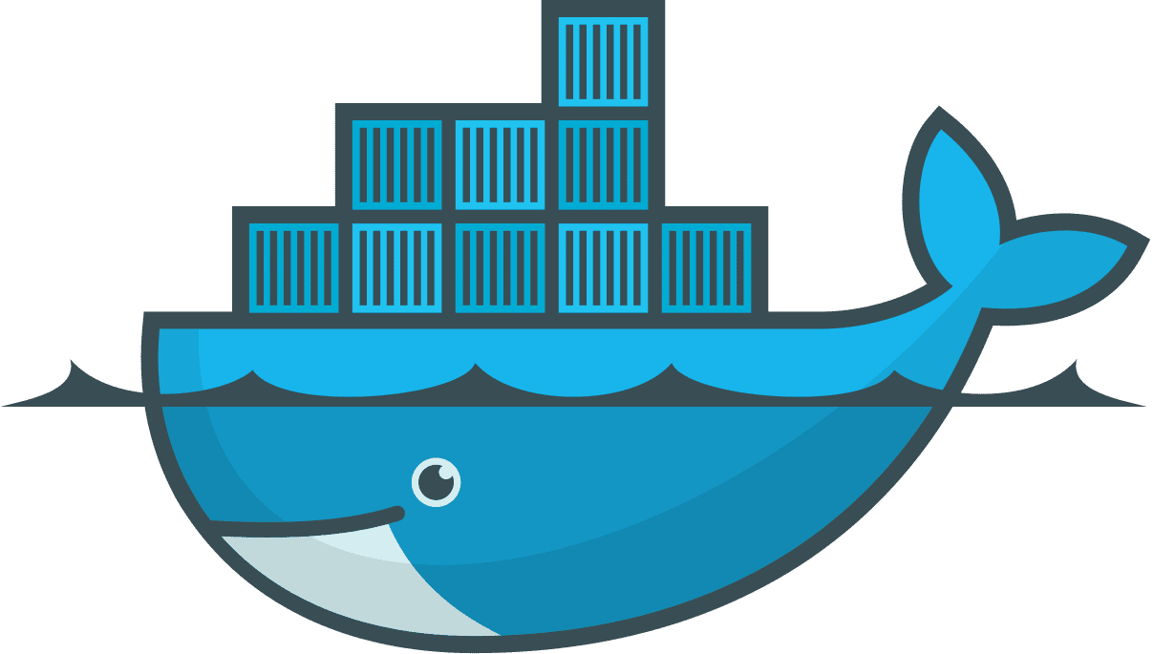
Introduction to Docker
aadesh.shrivastava@infosys.com

Slide 2
Agenda
Why we need Docker?
What is Docker?
Docker Platform
Docker Workflow

Slide 3
Why we need Docker?

Slide 4


Problems Before Docker
An application works in developer’s laptop but not in testing or production. This is due to difference in environments between Dev, Test and Prod.
Code works fine in my Laptop
There is some problem with the code
In Dev there can be a software that is upgraded and in Prod the old version of software might be present.
Dev
Prod

Slide 5
How Docker solves these problems
You can run several Microservices in the same VM by running various Docker containers for each Microservices.
In Dev there can be a software that is upgraded and in Prod the old version of software might be present.
Virtual Machine for starting multiple Microservices
Developer’s Laptop

Slide 6
Why Docker?
Isolation
Lightweight
Simplicity
Workflow

Slide 7
What is Docker?

Slide 8

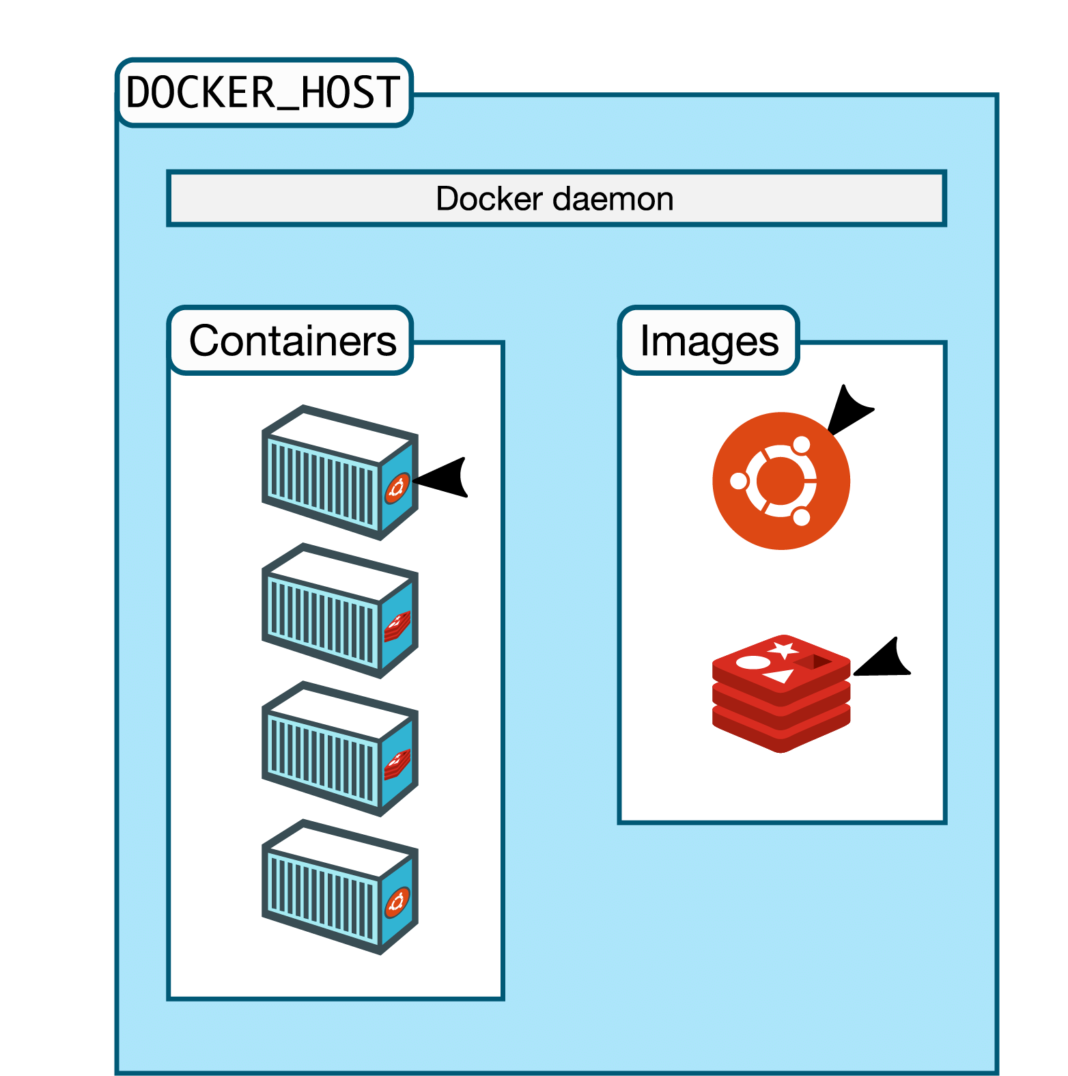
What is Docker?
Docker is a tool designed to make it easier to create, deploy, and run applications by using containers.
Docker containers are lightweight alternatives to Virtual Machines and it uses the host OS.
You don’t have to pre-allocate any RAMS in containers.

Slide 9
Docker in a Nutshell
In simplest terms, Docker containers consist of applications and all their dependencies.
They share the kernel and system resources with other containers and run as isolated systems in the host operating system.
The main aim of Docker containers is to get rid of the infrastructure dependency while deploying and running applications.
Technically, they are just the runtime instances of Docker images.

